Slide 1
Sentiment Analysis
Movie Review
-By Prateek Gupta

Slide 2
What is sentiment analysis?
the process of computationally identifying and categorizing opinions expressed in a piece of text, especially in order to determine whether the writer's attitude towards a particular topic, product, etc. is positive, negative, or neutral.
It uses data mining processes and techniques to extract and capture data for analysis in order to discern the subjective opinion of a document or collection of documents, like blog posts, reviews, news articles and social media feeds like tweets and status updates.

Slide 3
Different Sentiments
Movie Review: is the movie review positive or negative?
Customer Feedback: is customer happy with the services or probably angry?
Product: what do people think about the new iphone?
Politics: what do people think about the candidate?
Prediction: predicting election outcomes?
Stock Prices: fluctuation in stock prices ?

Slide 4
Movie Review
An article published in newspaper or magazine that describes and evaluates the movie. Reviews are typically written by journalists giving their opinions of the movie.
Movie reviews can also be just opinions given by people on the social media sites or movie booking websites.
The dataset we have taken is from the nltk.corpus official movie review dataset.

Slide 5
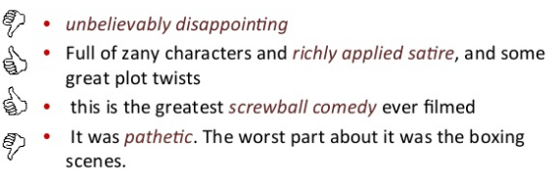
Positive and negative movie reviews?

Slide 6
Preprocessing
Converting all the words into sentences
Removing all the words of length smaller than and equal to two
removing the stop words like the , before , after , at etc.
Lemmitization of the words meaning converting words to their original forms
Like better – good, cats to cat, called to call etc.

Slide 7
Feature Extraction
From the pre-processed comments , getting all the words
Find the frequency of each word across all the reviews
Arranging the words according to frequency to get top 3000 words according to the most number of words
Using these words as the feature vector for each review
That is why now we have a 2000x3000 feature set of type Boolean
Diving the dataset into the testing and training set
1900 to training and 100 to testing.

Slide 8
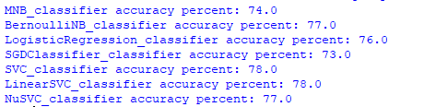

ML Models

Slide 9
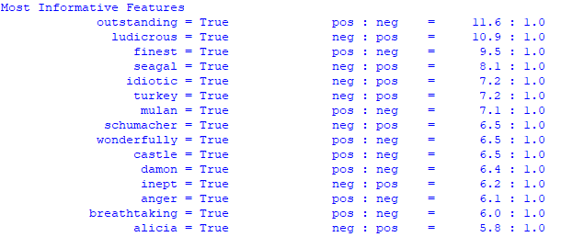
Most Informative Features

Slide 10
THANK YOU

